Slide 1
Allergy Journal Club
Jack McDonnell
January 15, 2020

Slide 2

Epicutaneous immunotherapy for the treatment of peanut allergy in children and young adults
Stacie M. Jones, MD, Scott H. Sicherer, MD, A. Wesley Burks, MD, Donald Y.M. Leung, MD, Robert W. Lindblad, MD, Peter Dawson, PhD, Alice K. Henning, MS, M. Cecilia Berin, PhD, David Chiang, MSc, Brian P. Vickery, MD, Robbie D. Pesek, MD, Christine B. Cho, MD, Wendy F. Davidson, PhD, Marshall Plaut, MD, Hugh A. Sampson, MD, Robert A. Wood, MD
Journal of Allergy and Clinical Immunology
Volume 139, Issue 4, Pages 1242-1252.e9 (April 2017)
DOI: 10.1016/j.jaci.2016.08.017

Slide 3
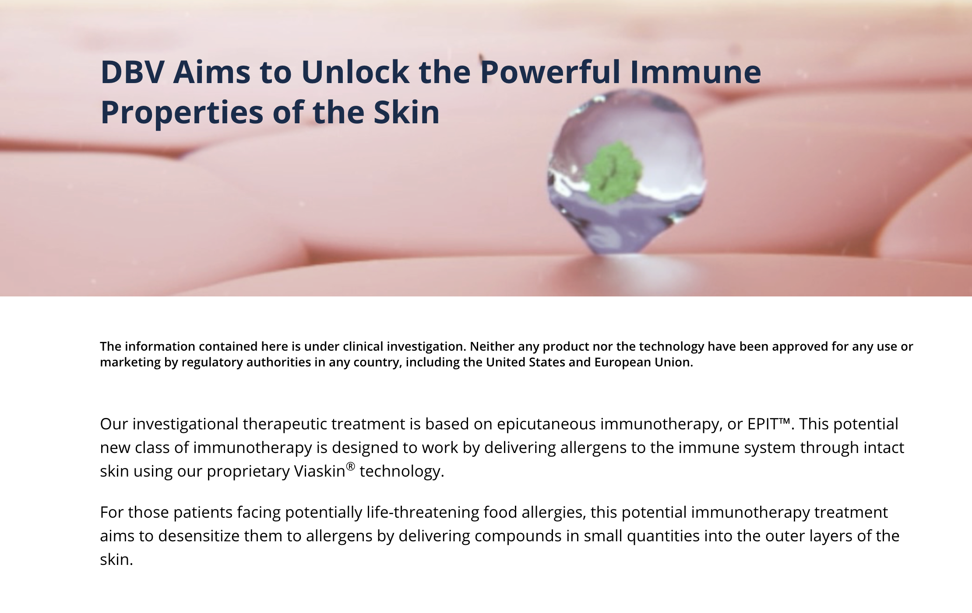
How is this supposed to work, anyways???

Slide 4
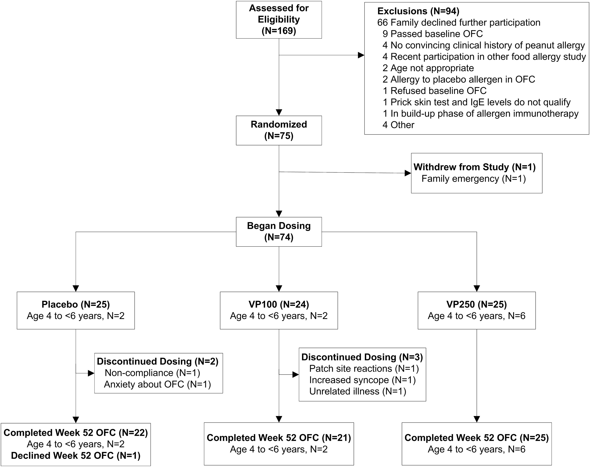
Figure 1

Slide 5
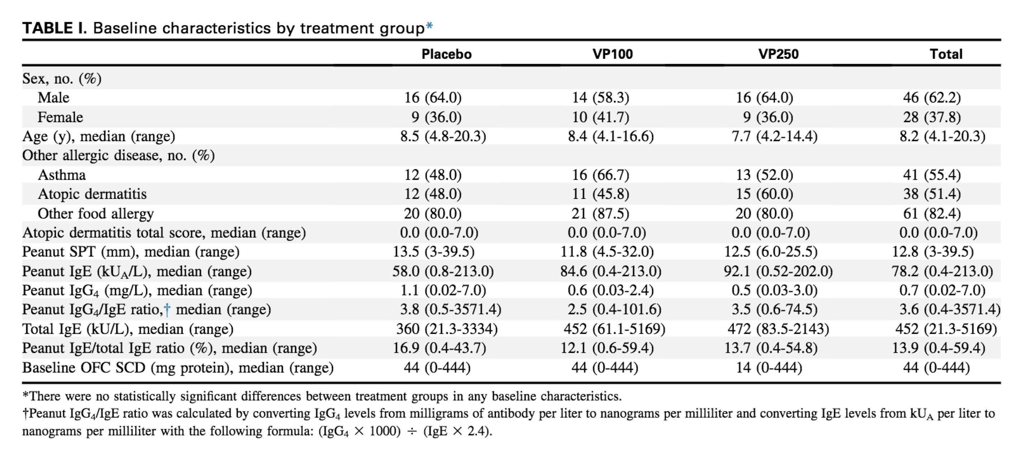

Slide 6
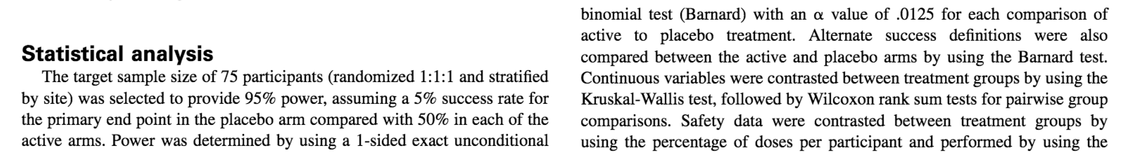

Slide 7
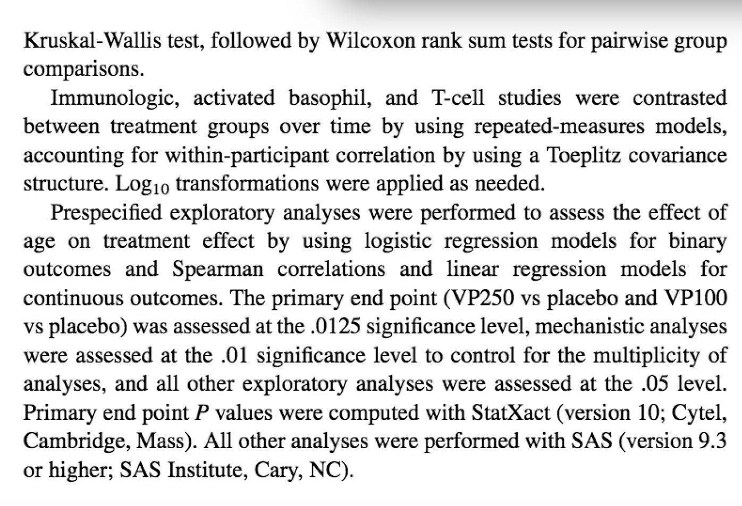

Slide 8
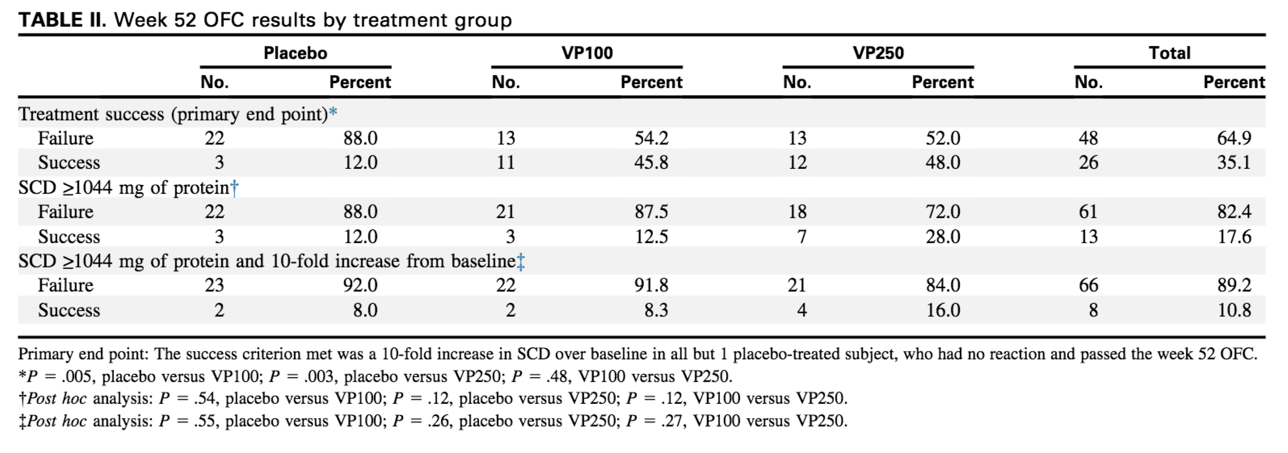

Slide 9
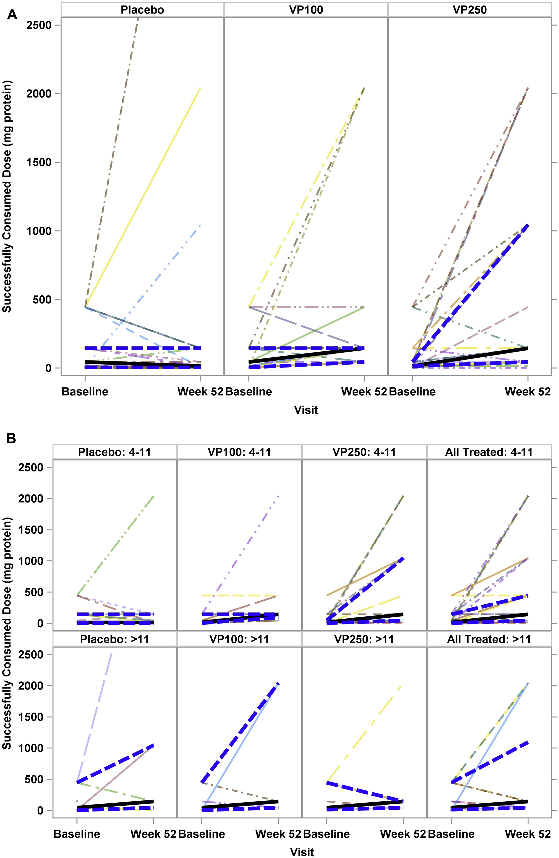
Figure 2

Slide 10
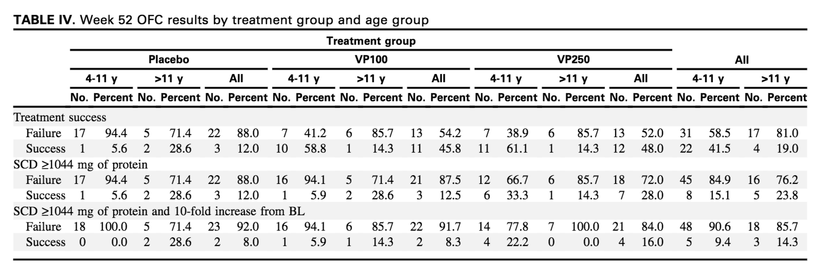

Slide 11
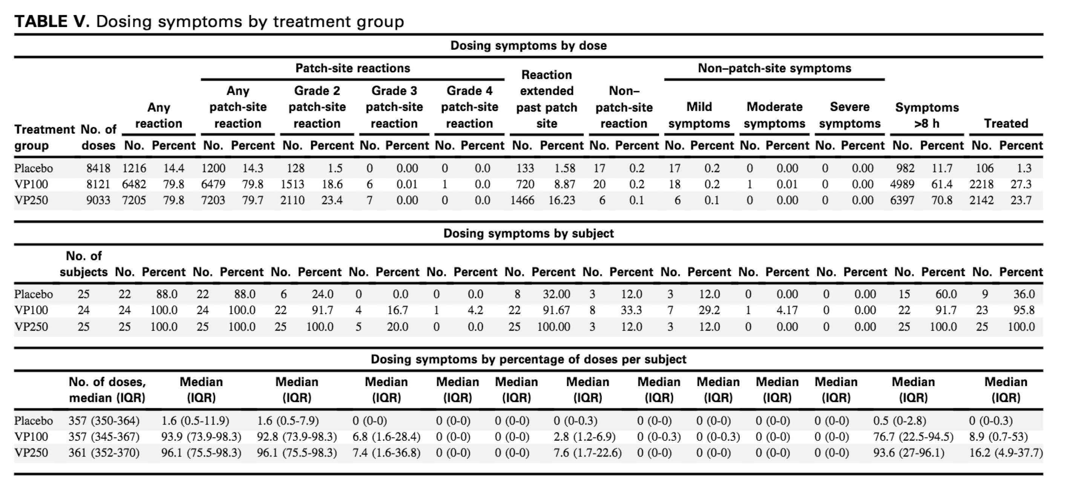

Slide 12
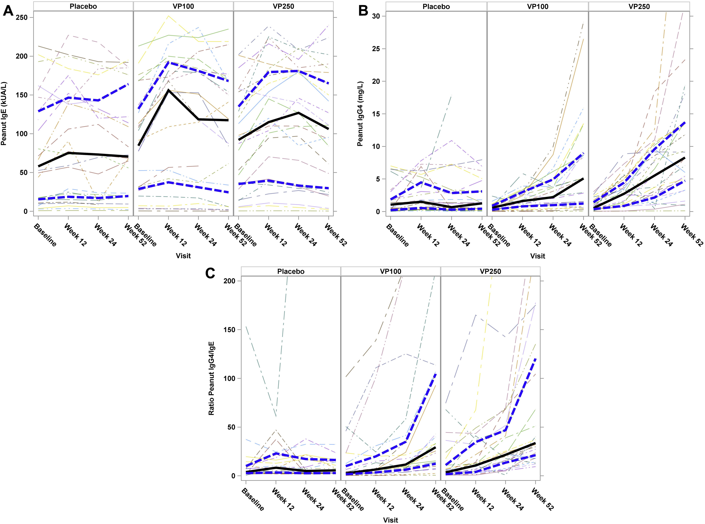
Figure 3

Slide 13
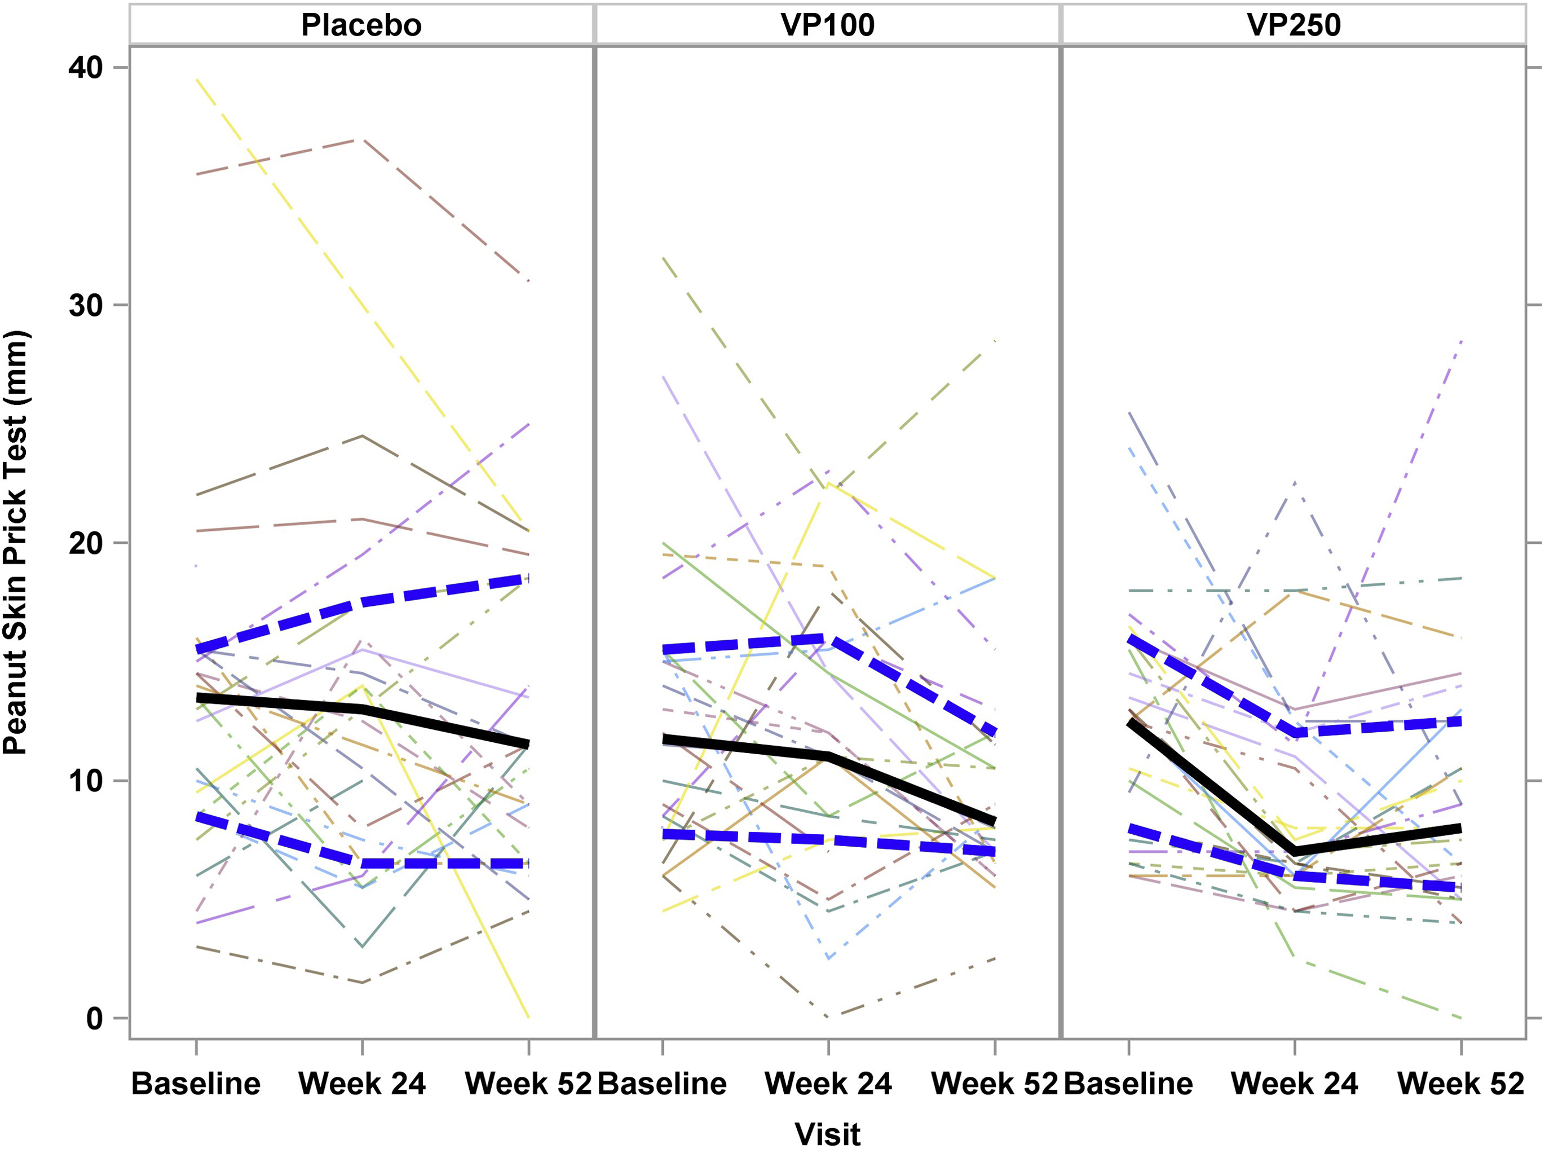
Figure 4

Slide 14
Summary
Peanut EPIT administration was safe (local reactions common)
Modest treatment response after 52 weeks, with the highest responses among younger children

Slide 15
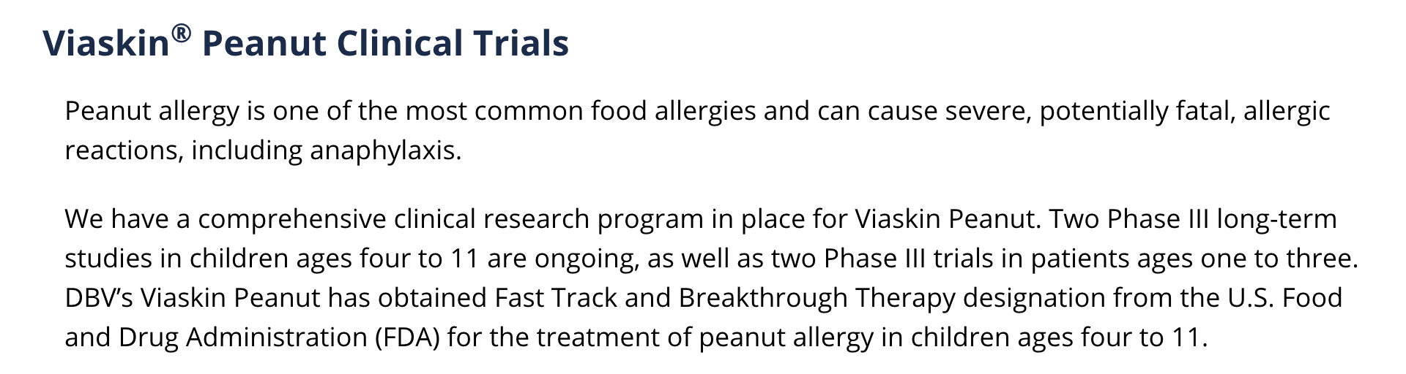

Slide 16
Considerations
Generalizability?
Treatment effect persistence beyond 52 weeks?
Differential patch reactions (were folks really blinded?)
Was 5044mg a good target?
1 peanut = 250mg peanut protein
5044mg/250mg = 21 peanuts
Typical serving size of peanuts = 28 peanuts
Is this approach “worth it”?

Slide 17
